Slide 1
AL TAMAUEZ AL RAQI LLC
Profile and Exclusivity

Slide 2
Al Tamauez Al Raqi LLC
About Us
Since 2005 Al Tamauez Al Raqi LLC, have immense pleasure in introducing our self as one of the leading marine & Industrial Suppliers and Ground support equipments for Airport Authority and maintenance service for all the engine and spare parts we are experts in Sultanate of Oman
Our Operations
Supply of Marine Spares
Ground Support Equipments
Supply of Communication Equipment
Dress Accessories for Military
Flags & Gifts Items
Oil and Gas Spare Parts
Marine services and maintenance

Slide 3
Outline
Tamauez Short Profile
General - Experience Counts
Commitment To Safety and Environment
Clients of Tamauez
Participant in national and international exhibition
Achievements
Contact Details.

Slide 4
Tamauez Short Profile
AL TAMAUEZ AL RAQI LLC involved in Maintenance business for the last 12 years
We provide a diverse range of products to suit all our customers needs; It all ranges from fire fighting equipments to military accessories with catalogues to suit our needs.
We Are also proud to maintain a very long and committed relationship with our global suppliers, that handle high grade in Ground support equipment for Airport service And since quality control and after sales assurance is our motto we have hand picked the best craftsmen and engineers to suit our customers needs and expectations.

Slide 5
Tamauez Short Profile Contd..
In a short span of time, we have become synonymous with just about any component that has to deal with diversified military, marine, industrial and communication equipments and maintenance. The company is best in Al-Gubra north tanaf house building 2nd floor.
We are one of the most reputed distributors and stockists of a wide range of component, spares and tools for the industry
As an Acknowledgement to our commitment, we have a long list of satisfied clients including some of the most reputed firms in the sultanate of Oman.
Quality and reliability is our motto.
Marine maintenance and services is our speciality.

Slide 6
Mission and Vision Statement?
What makes us special is our contribution to the In-Country Value (ICV) since we have a full Omani management board.
About Our Values:
Our fundamental company values enable us to perform our mission in the best way possible:
Bring hi-tech solutions to our local problems
Honest and integrity
Reliability and Trust
Innovation and Creativity
Professional and dedication

Slide 7
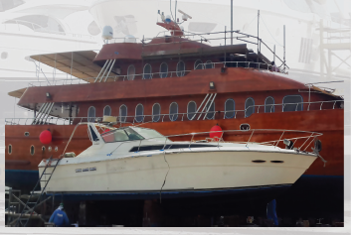
General - Experience Counts
AL TAMAUEZ AL RAQI LLC Maintaining business for the last 12 years.
We are one of the suppliers military requirements in Sultanate of Oman . we are supplying to the. Air Force, Army , Navy , Police, Yachts, Duqm Port and also Industrial Companies in Oman.
We have experience in Maintenance & different types of services from our clients. All our services were met with a great satisfaction among our customers.

Slide 8
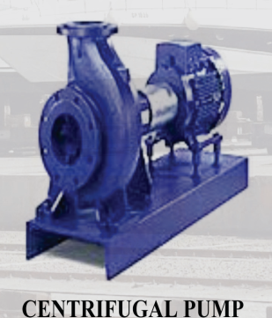
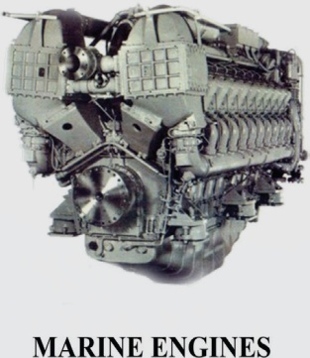
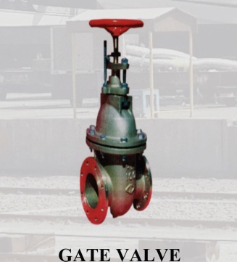
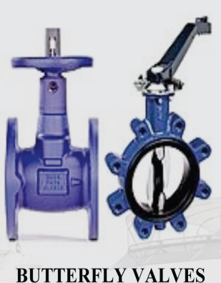
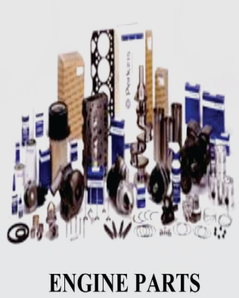
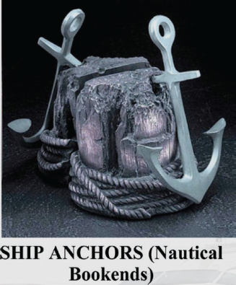
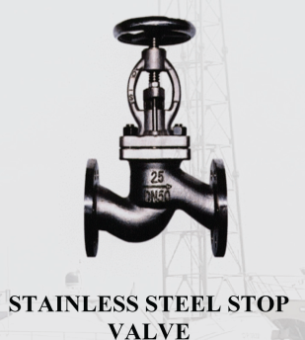
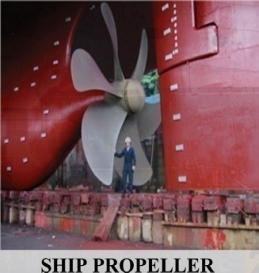
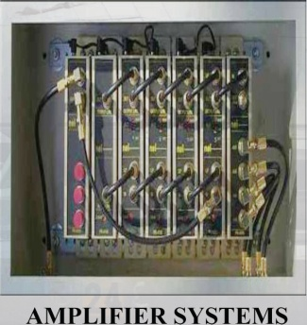
General - Experience Counts
A wide variety of spare parts
All Marine Engine Parts
All electrical parts
All mechanical parts
Ship Propeller
Gate Valve
Ship Anchors(Nautical Bookends)
Amplifier System
Centrifugal Pumps
Butterfly valves
Headsets
Stainless steel stop valve
Ship Anchors
And many more

Slide 9
General - Experience Counts
We Are also proud to maintain a very long and committed relationship with our global suppliers, that handle high grade in Ground support equipment for Airport service And since quality control and after sales assurance is our motto we have hand picked the best craftsmen and engineers to suit our customers needs and expectations.

Slide 10
General - Experience Counts

Slide 11
Ship Services
The ship services cover all aspects of repairs, reconditioning, services and maintenance on ships, sailing or docking.
Tamauez provide:
Blasting and painting of hull – superstructure- deck –hatches – covers – pipelines.
Cleaning of ER bilges – tanks – cargo tanks – storage tanks – fresh water tanks
Steel renewal
Piping work
Recondition work.

Slide 12
Diesel Engine
Diesel engine repair and maintenance is the core service of Tamauez. We perform routine maintenance, trouble shooting, and repair on major makes of main and auxiliary diesel engine with specialized OEM trained engineers.
We also carry out new installations and retrofit on the following:
All medium and slow speed engines
Main propulsion
Auxiliary engines
Stationary engines
Skid mounted generator sets

Slide 13
Diesel Diagnostic Services
The benefits of this service to the customer are reduced off-hire, reduced spare part consumption and better intelligence to accurately predict operating costs.
The diagnosis we provide tells us the condition of the engine and so we are able to advise on preventative maintenance and any corrective action required as well as optimising engine performance.

Slide 14
Governors
Tamauez offers repairs on an exchange basis for many types of governors. we also offers technical Consulting for new installations, maintenance and troubleshooting.
Types of Products Supported and Sold
• Governors
• Actuators
• Amplifiers
• Electronic controls for diesel engines
• Electronic controls for steam turbines
• Electric Controls for gas turbines
• Compressor anti-surge controls
• Power management controls
• Gas turbine fuel valves

Slide 15
Fuel Equipments
Tamauez has a long tradition in fuel equipment repairs and service. We have a fully equipped workshop staffed by highly skilled technicians using special equipment for diagnosis, repair and testing.
We overhaul all types of fuel pumps and injectors and offer our own range of standard sized and oversized plungers.

Slide 16
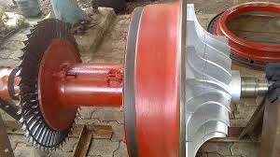
Turbochargers
The standard overhaul of a turbocharger consists of opening up, cleaning the rotor, ash blasting, repair and balancing.
We overhaul all types of turbochargers and supply top quality high performance spare parts.
Our services include complete turbocharger overhaul in our workshop and afloat including rotor balancing in-situ.

Slide 17
In Situ - Services
we also carry out in –situ machining on the following:
Propeller shaft, thrust shaft
Intermediate shaft journals
Engine block landings surface
Winch brake drums and shaft
2 stroke engine liners
Pipe flanges, foundations
Cylinder blocks
Trust faces, etc.

Slide 18
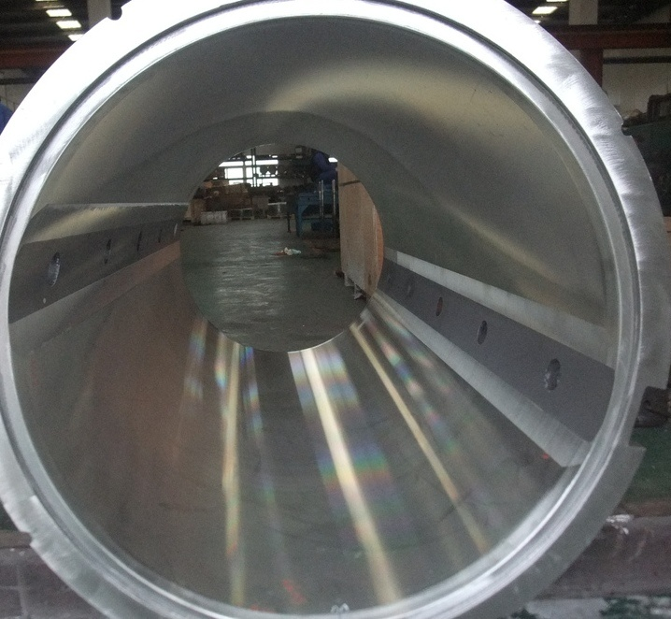
Rebabbitting
We carry out this activity using specially developed tools, equipment, procedures and our own highly trained workforce on items such as the following.
Crankshafts bearings
Crosshead bearings
Intermediate bearings
Pump bearings
Main gear bearings
Thrust pads for main shaft, turbines, crankshaft
Stern Tube bearings

Slide 19
Electro-Automation Low and High Voltage
We carry out all aspects of installation, repair, reconditioning, services and maintenance of marine, oil and gas and industrial installations.
We provide our services on the following equipment.
Switch board
Power generators/alternators
Voltage regulators
Starter panels
Power distributor lines
Cables
Electric motors
Electric installations
Alarm and control systems

Slide 20
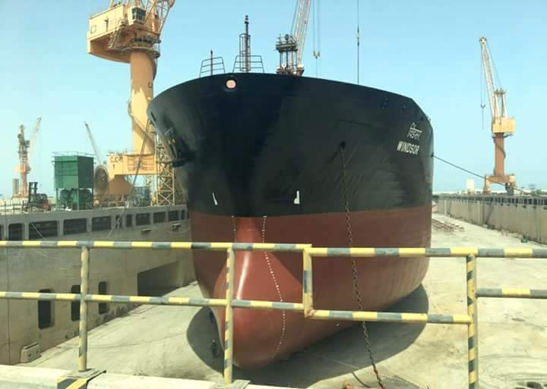
Hydraulic Services
We cover all aspects of repair, reconditioning, services and maintenance of marine, oil and gas and industrial installation such as:
Electro hydraulic cranes
Towing winches
Mooring winches
Anchor windlass
Thruster (electro and diesel driven)
Tank control system
Cargo grabs
Steering gear.

Slide 21
Vacuum Pressure Impregnation Plant
The VPI Process provides many benefits to the user. It completely seals the windings against moisture and vibration, provides greater mechanical strength, and improved corona protection. it vastly improves performance and reliability even in the harshest working environments. Machines last longer and require less maintenance. VPI is a process, whish provides positive pay back over a short period of time.
Tamauez has the biggest VPI plant operating in the region. The plant is 3m diameter x 3m depth. The equipment is designed to process the broadest range of products, from small AC/DC coils up to 11KV machines.

Slide 22
Testing Facility
Testing facility for bearing temperature monitoring
Hot spot test of stator core.
Phase comparison test after rewinding.
Test equipment to test coils for internal insulation leakage.
Test equipment to test rotor for internal cracks/ condition.
In-house facility of rebabbitting of white metal bearing and machining.
All kind of lathe machines, boring machines and milling machines work in house.

Slide 23
Automation
Tamauez set up their automation shop to provide specialist services in electronic, pneumatic and hydraulic systems, and has emerged as a major partner for the shipping industry in these specialized fields.
Boiler Automation
Engine Remote Control
Bridge control
Engine Alarm systems
Inter Gas control and Automation
Steering Gear controls
Lift controls
Oil Discharge Monitoring systems

Slide 24
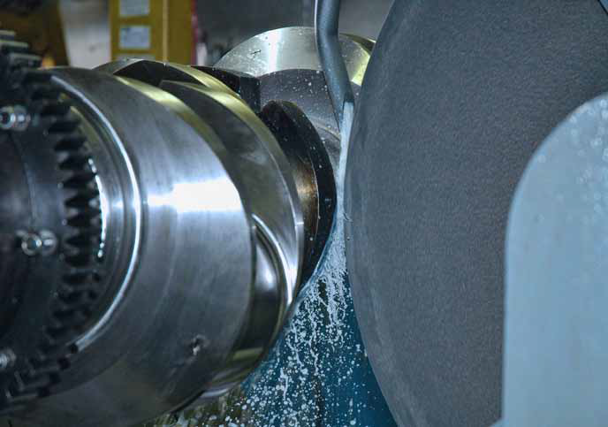
Workshop Reconditioning Service
Tamauez have a fully equipped workshop providing support to all of our main service components and also offer a wider range of reconditioning on the following:
Fuel injectors , nozzles, valves and pumps
Centrifugal casting of white metal bearings & stern tubes
Crankshaft
Connecting rods
Exhaust valve spindles , seats and cages
Cylinder liners
Piston crowns
Cylinder heads / covers
Heat exchangers
Cargo & service pumps
Governors and Electric motors {Rewinding}

Slide 25
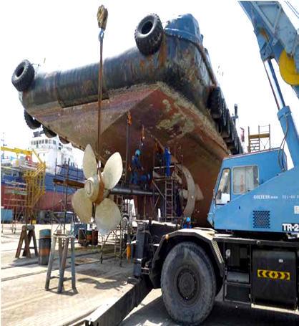
Ship Docking –Mechanics
Tamauez located in Oman, offers a great advantage for dry docking of vessels and tugs adjacent to our main workshops and offices facilities.
We also offer a wide range of mechanical and general ship repair services from our AFLOAT department based at the same location.
Services provided as follow:
DRY – DOCKING
Capacity up to 6000 Tons
H.P water washing
Blasting and painting
Tank coating
AFLOAT – Services and mechanics
Pumps and cow mechanics
Winches
Valves, derricks. Cranes
Propellers, shafts, rudders
Compressors , IG and ER Fans

Slide 26
Steel Fabrication Repairs
We generally do fabrication
work as follows:
Hull structure
Superstructure
Marine Cranes
Cranes, jibs, Davits, Foundations
Cargo hatches and covers
Ballast & cargo tanks
Handrails , ladders & platforms
Safe access to bow arrangements
Class approved towing brackets.

Slide 27
Tamauez Priorities
COMMITMENT TO SAFETY AND ENVIRONMENT
Thorough initial and ongoing safety and technical training for staff and consultants for Tamauez operations, consistent with requirements from our clients.
Strict adherence to safety procedures with particular emphasis on personal protective equipment (PPE) for the individual and his/her colleagues.
Employees are encouraged to intervene in situations that are contrary to established safety or environmental policies and procedures.
Structured safety and environmental reporting and tracking, including a key learning process, for incidents and near misses.
Actively identify and quantify safety and environmental improvements that may be realized by alternative operating practices and equipment selection for client consideration.
Utilize appropriately engineered equipment for all Tamauez services to ensure quality, efficiency and safety of our offerings

Slide 28
CLIENTS OF AL TAMAUEZ AL RAQI LLC
Ministry of Defence
Royal Navy of Oman
Royal Air force of Oman
Royal Police of Oman
Royal Court Affairs Yachts
Safety & Security
Military Technological College
Royal Army of Oman
Oman Dry Dock Duqm
Sohar Aluminium

Slide 29
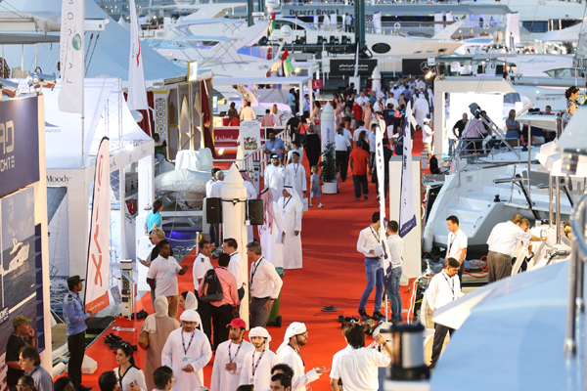
Participant in Dubai International Boat Show
We are glad to represent our company at international level in 2016

Slide 30
Participate in muscat Exhibition

Slide 31
Tamauez- Service and Maintenance in Oman

Slide 32
Our Achievements

Slide 35
Contact Us
AL Tamauez AL Raqi L.L.C
P.O. Box: 983 P.C: 130,AL Azaiba
Muscat , SULTANATE OF OMAN)
Tel : (+968) 24499633, Fax : (+968) 24499611
GSM :(+968) 99422232 - 93222036
Email id: yousuf@tamauez.om
Website: www.tamauez.om

